Slide 1
Web development

Slide 2
Edgar vargas
Bachelor’s degree in Computer Science from ITCR
Master degree in Computer Science from UCR
Full Stack developer with 15+ years of experience
Worked on companies like LD, HP, Intertect, Intel
Joined Intel in 2015
Tech Lead in CCRE APT
TLP member
App Development CoP
TDD trainer

Slide 3
Agenda
Web Development Evolution
Basic Concepts
HTML
CSS
JavaScript
SPA and PWA
Current Technology Stack
PreWork
Notes:
2:00 – 2:10 Introduction
2:10 – 2:20 Web Development Evolution
2:20 – 2:30 Basic Concepts
2:30 – 2:50 HTML and HTML5
2:50 – 3:10 CSS, SCSS and Bootstrap
3:10 – 3:30 JavaScript and Typescript
3:30 – 3:40 SPAs and PWAs
3:40 – 3:50 Current Technology Stack, mention MVC
3:50 – 4:00 PreWork

Slide 4
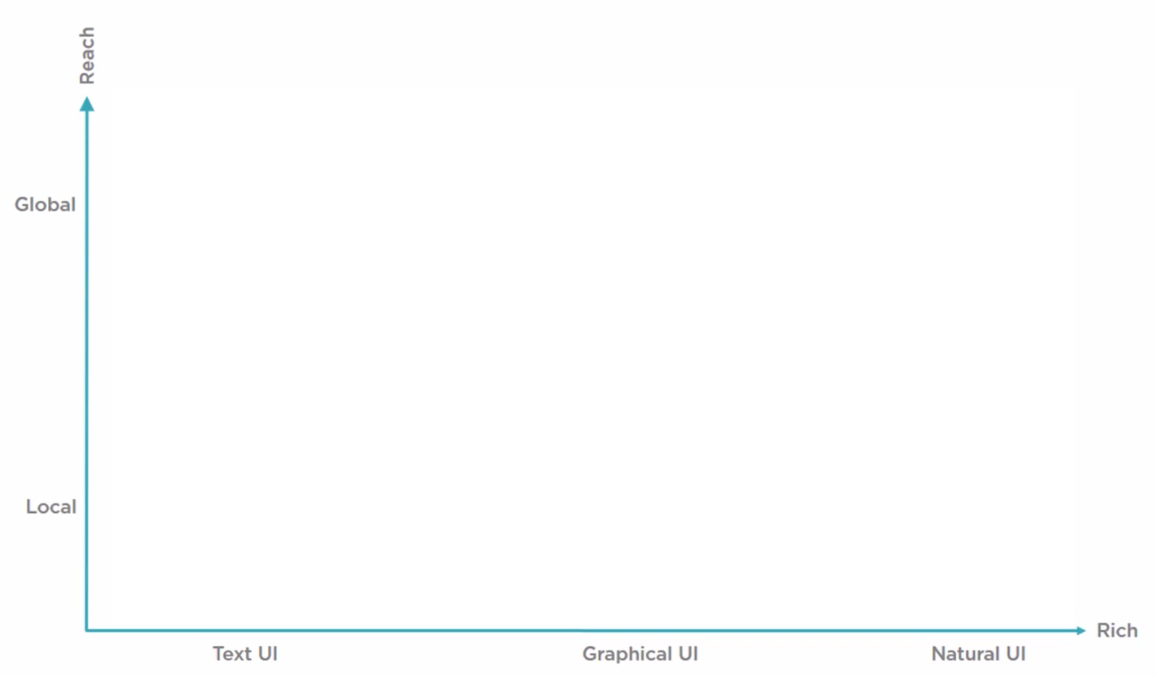
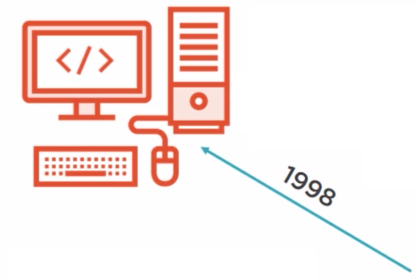

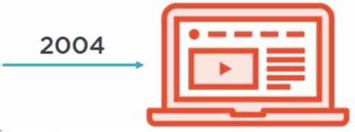
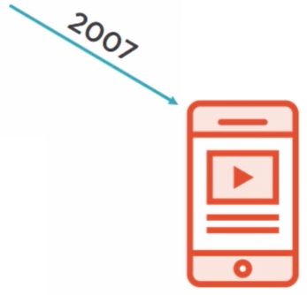
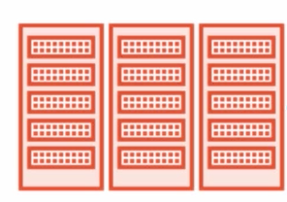
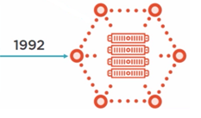
History and evolution
Notes:
Reach = make the application available to anyone anywhere
Richest = how rich the client side interactivity and how intuitive the User Interface is to use
In the beginning, applications were not very rich and were only used locally.
Ej: command line tooling, black and white screens
Around 1992, we began to explore the next phase of applications evolution: Graphical user interfaces; much more rich but still quite local
Then, sometime around 1998 the web really began taking off.
It was a great step forward for Reach (because we could build web pages to be available to anyone anywhere) unfortunately the Web 1.0 was very limited to mostly just text and maybe some basic images.
Over the years things on the web got better and better and richness increased.
In mid 2000s (2004, 2005, 2006) when Silverlight and Flash allowed us to play video, and audio, and have animations, interact with web cams and microphones.
But in 2007 everything changed when Steve Jobs presented the iPhone.
Although Steve Jobs encouraged people to continue building web applications, he was not a big fan of Flash or Silverlight and he never allowed them to run in the iPhones.
In 2008 Apple introduced their native application SDK which began the era of the App.
Apps took a step back on Reach but they are more reachier experiences: they use touch and gestures, and then eventually added voice control. These are very natural interfaces for humans to interact with.
Unfortunately, unlike the Web, Apple’s native SDK was proprietary, and its huge success made other Phones manufacturers to follow the same approach with their own SDKs. It was a major step forward on Richness but a big step backwards on Reach. Since then the companies have been forced to have separate teams to create their Apple and Android apps and whatever other teams they need to support other platforms available.

Slide 5
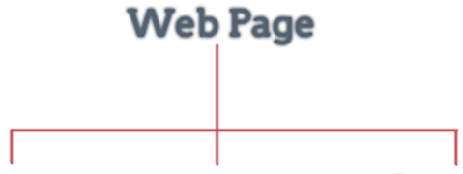

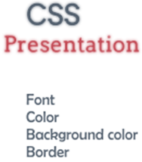
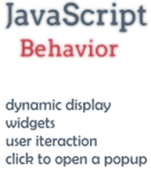
Basic Concepts
Notes:
Demo
Mostrar Devloper Tools de Chrome

Slide 6



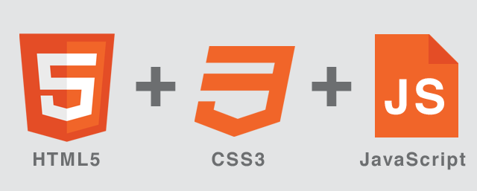
Basic Concepts
Cliente
Servidor
http request
Base de Datos
URL
Web
Server
http response
Notes:
1 – Usuario utiliza un cliente, normalmente el browser en su laptop, cellular o tablet
2 – El cliente solicita un URL (Uniform Resource Locator) es como el identificador unico del recurso en Internet
3 – El cliente manda un http request al Servidor (Verbos HTTP más communes son el GET y el POST)
4 – El servidor procesa la solicitud, posiblemente sacando datos de la BD
5 – El servidor envía de Vuelta un http response con la información solicitada
6 – La respuesta es desplegada en el cliente

Slide 7


Slide 8
HTML
Hypertext Markup Language
HTML describes the structure of a web page
Consists of a series of elements, known as tags
Browsers do not display the HTML tags, but use them to render the content of the page

Slide 9
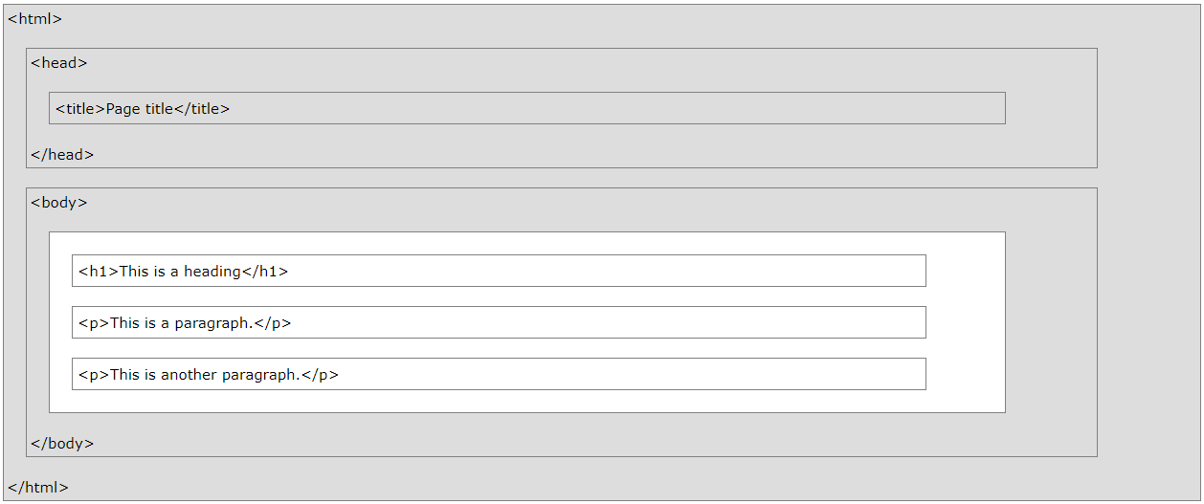
HTML Page Structure

Slide 10
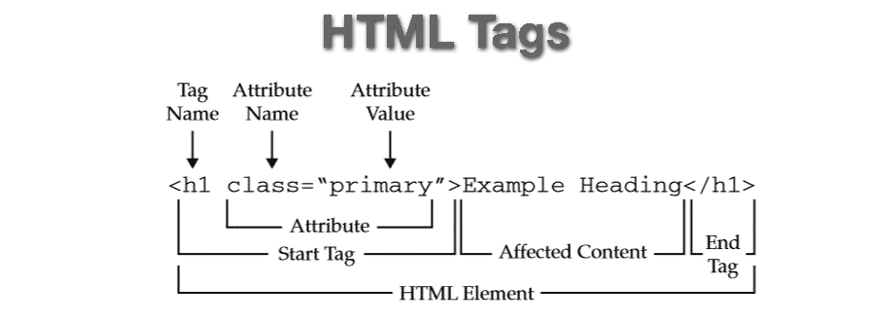
HTML Tags and Attributes
Notes:
HTML tags are element names surrounded by angle brackets
HTML tags normally come in pairs like <p> and </p>
The first tag in a pair is the start tag, the second tag is the end tag
The end tag is written like the start tag, but with a forward slash inserted before the tag name
All HTML elements can have attributes
Attributes provide additional information about an element
Attributes are always specified in the start tag
Attributes usually come in name/value pairs like: name="value"

Slide 11
Commonly used HTML elements
<!-- Comments -->
<a href=“URL”>Title</a>
<button>
<form>
<h1> to <h6>
<img src=“…” alt=“”>
<ul> <ol> <li>
<p>

Slide 12
Commonly used HTML elements
<div>
<span>
<input>
text
radio
checkbox
<select> <option>
<table> <th> <tr> <td>

Slide 13


Slide 14
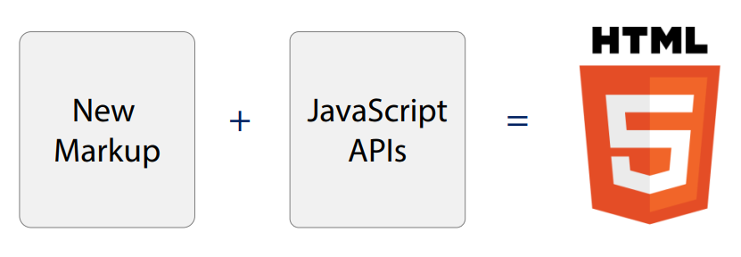
What’s HTML5
HTML5 is a markup language used for structuring and presenting content on the World Wide Web.

Slide 15
Semantic/Structural elements
A semantic element clearly describes its meaning to both the browser and the developer.
Examples of non-semantic elements:
<div>
<span>
Examples of semantic elements:
<form>
<table>
<article>

Slide 16
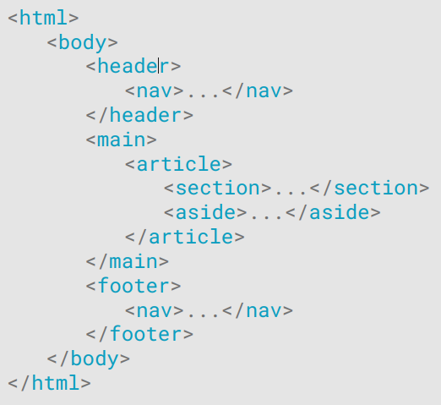
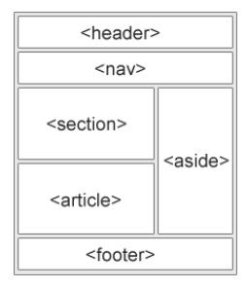
Semantic/Structural elements
Many web sites contain HTML code like: <div id="nav"> <div class="header"> <div id="footer"> to indicate navigation, header, and footer.
HTML5 offers new semantic elements to define different parts of a web page:

Slide 17
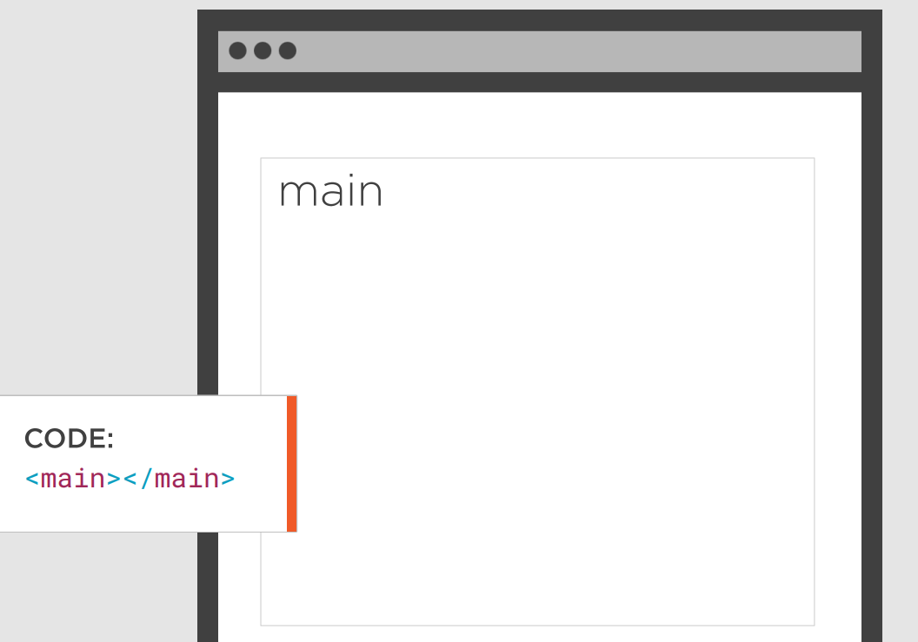
Main
Specifies the main content of a document
There must not be more than one <main> element in a document
Must NOT be a descendant of an <article>, <aside>, <footer>, < header>, or <nav> element

Slide 18
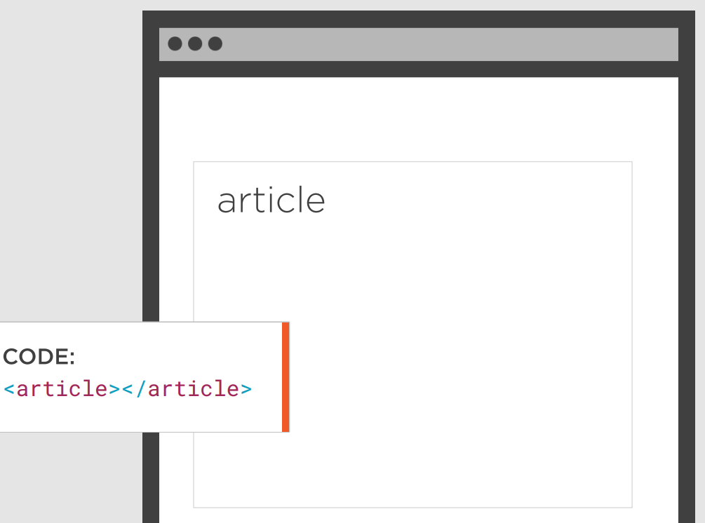
Article
The <article> tag specifies independent, self-contained content
An article should make sense on its own and it should be possible to distribute it independently from the rest of the site.
Potential sources for the <article> element:
Forum post
Blog post
News story
Comment

Slide 19
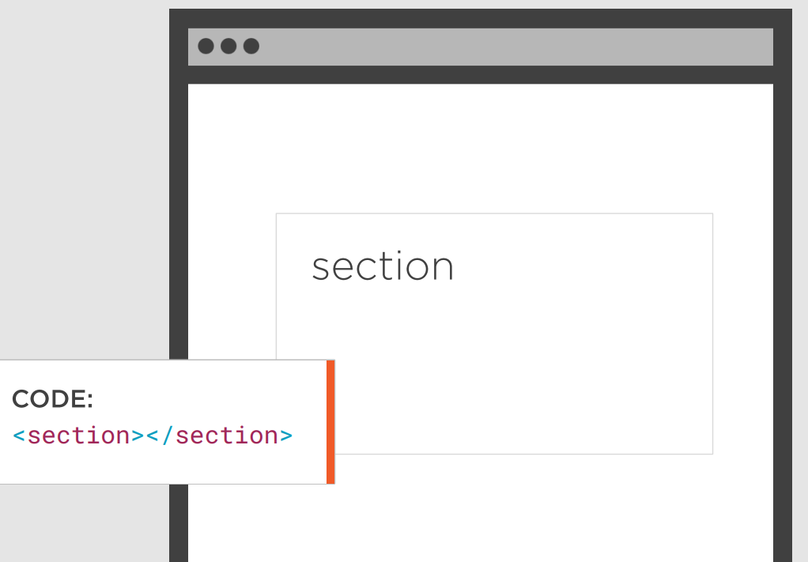
Section
The <section> element defines a section in a document, such as chapters.
According to W3C's HTML5 documentation: "A section is a thematic grouping of content, typically with a heading."
A home page could normally be split into sections for introduction, content, and contact information.

Slide 20
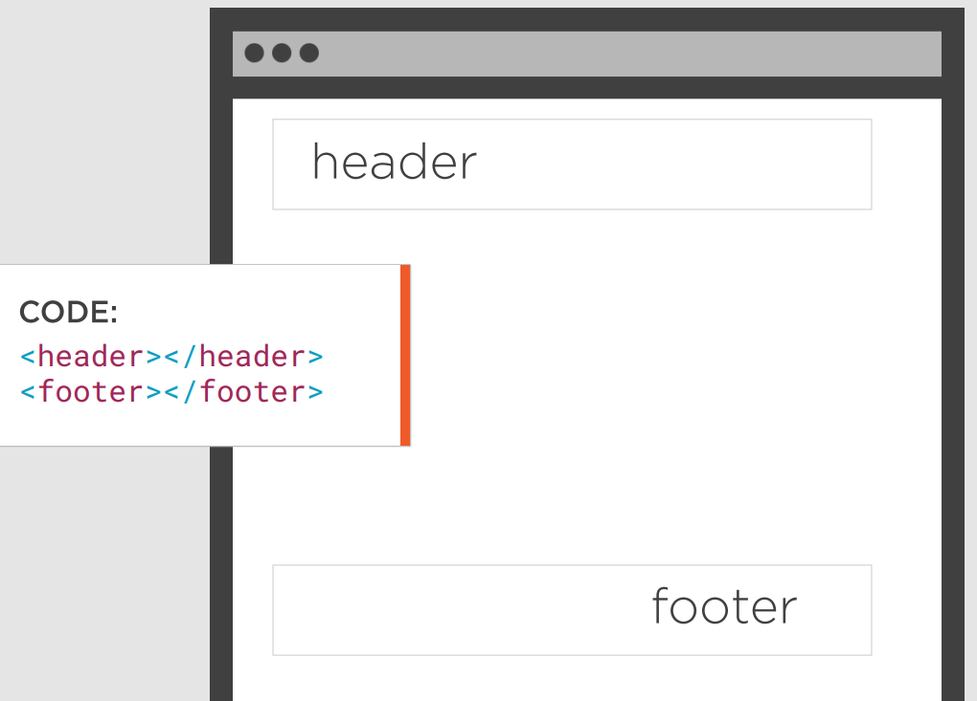
Header & Footer
The <header> element specifies a header for a document or section.
The <header> element should be used as a container for introductory content
The <footer> element specifies a footer for a document or section.
A footer typically contains the author of the document, copyright information, links to terms of use, contact information, etc

Slide 21
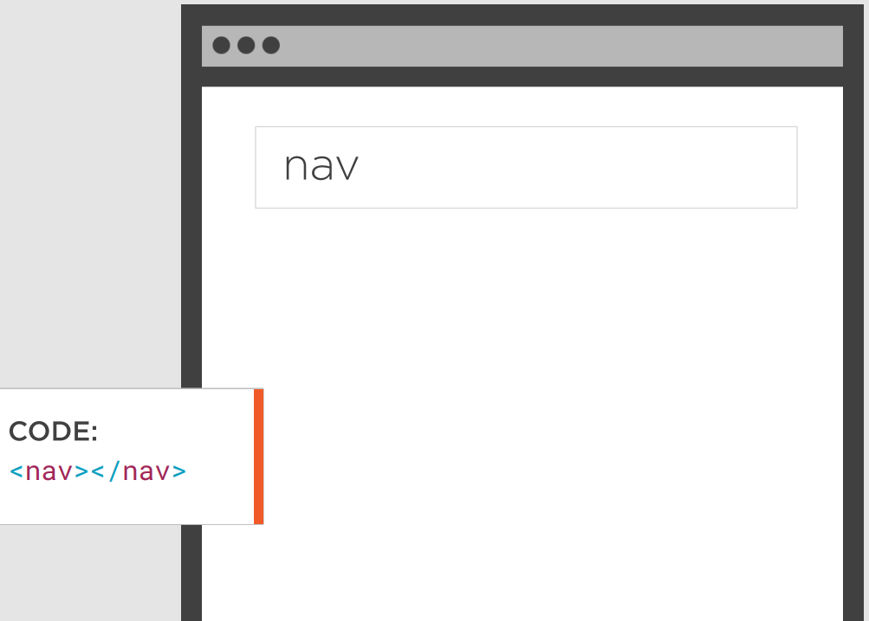
Nav
The <nav> element defines a set of navigation links.
NOT all links of a document should be inside a <nav> element
The <nav> element is intended only for major block of navigation links.

Slide 22
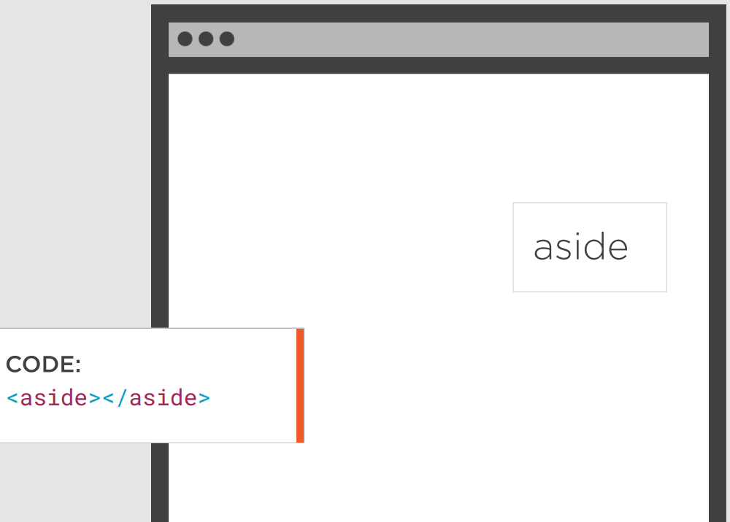
Aside
The <aside> element defines some content aside from the content it is placed in (like a sidebar)
The <aside> content should be related to the surrounding content

Slide 23
Form elements
HTML5 added several new input types:
color
date
datetime-local
email
month
number
range
search
tel
time
url
week
Input types that are not supported by older browsers, will behave as <input type="text">

Slide 24
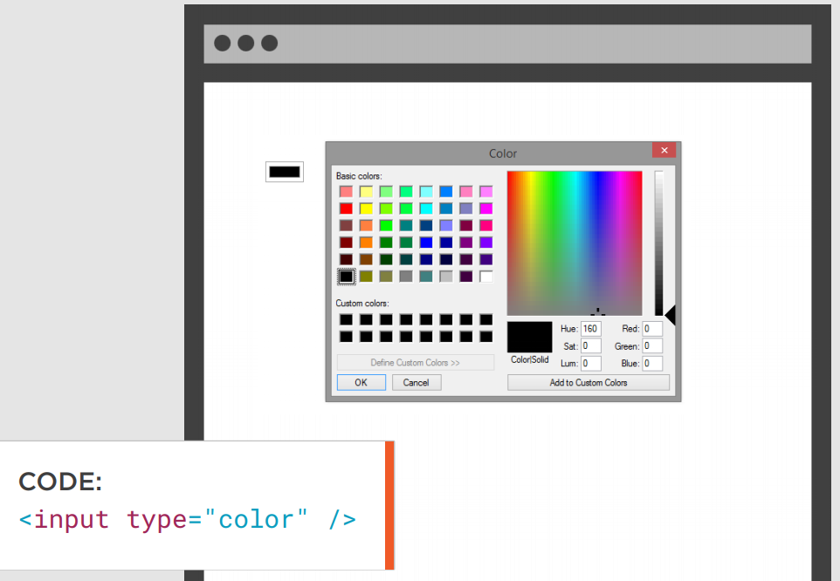
Color
The <input type="color"> is used for input fields that should contain a color.
Depending on browser support, a color picker can show up in the input field

Slide 25
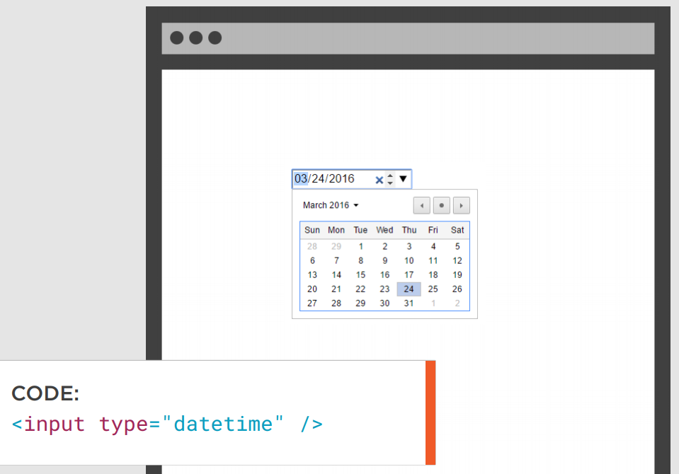
Date
The <input type="date"> is used for input fields that should contain a date
Depending on browser support, a date picker can show up in the input field

Slide 26
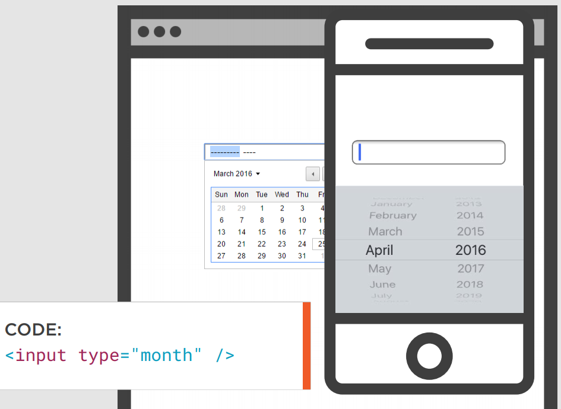
Month
The <input type="month"> allows the user to select a month and year
Depending on browser support, a date picker can show up in the input field

Slide 27
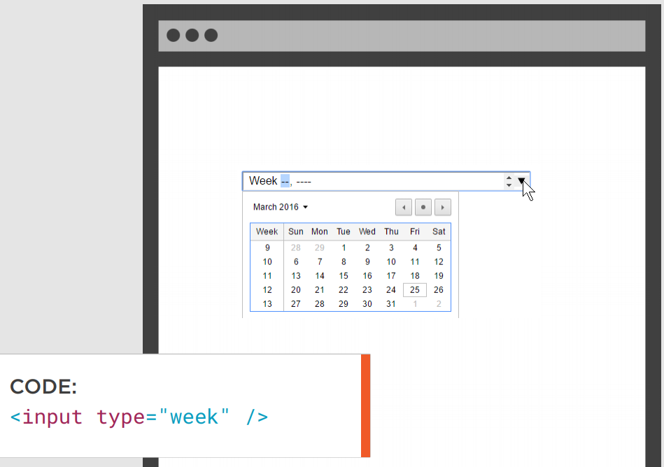
Week
The <input type="week"> allows the user to select a week and year
Depending on browser support, a date picker can show up in the input field

Slide 28
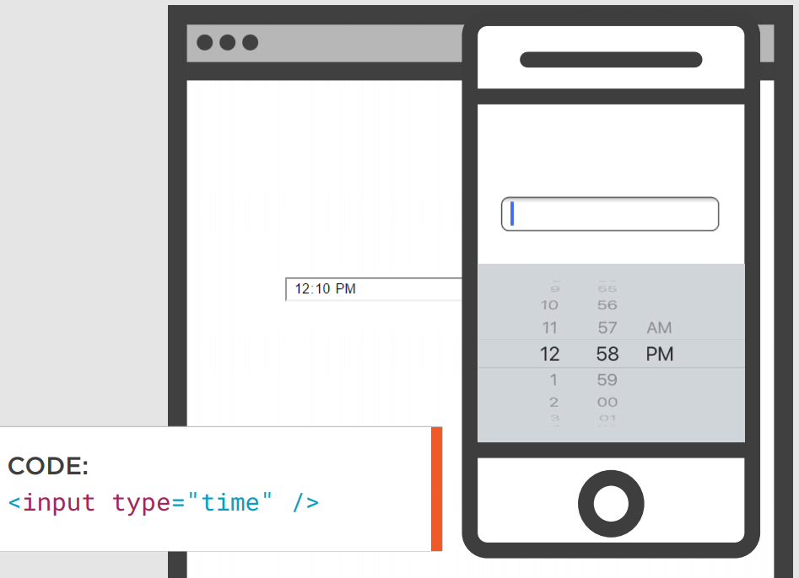
Time
The <input type="time"> allows the user to select a time
Depending on browser support, a time picker can show up in the input field

Slide 29
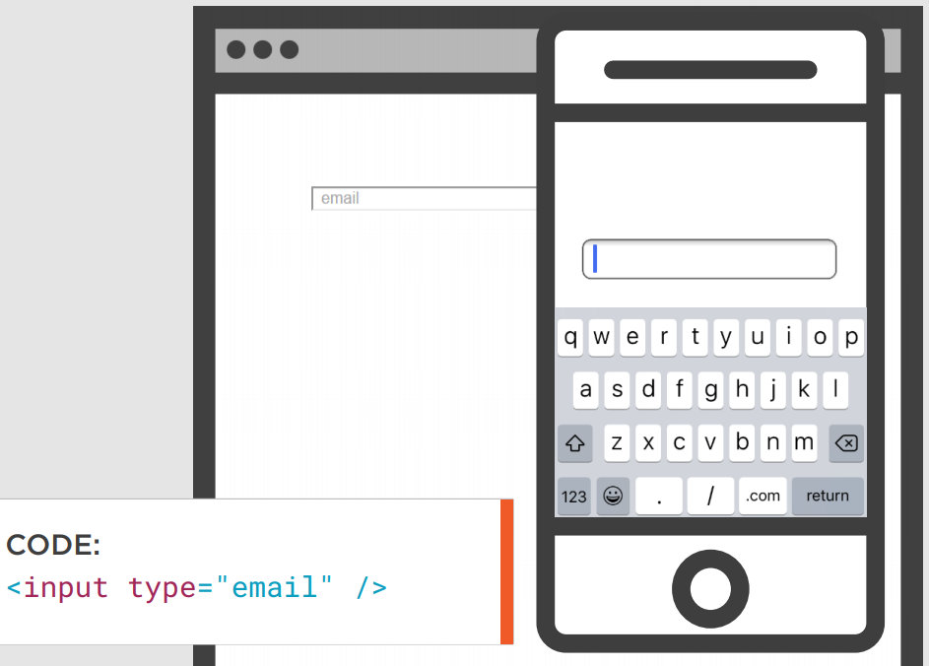
Email
The <input type="email"> is used for input fields that should contain an e-mail address
Depending on browser support, the e-mail address can be automatically validated when submitted

Slide 30
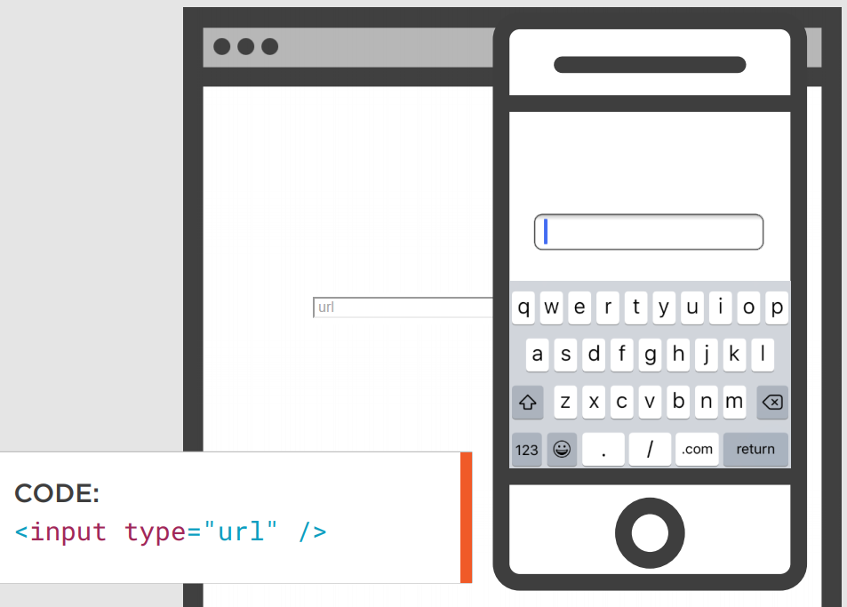
URL
The <input type="url"> is used for input fields that should contain a URL address
Depending on browser support, the url field can be automatically validated when submitted

Slide 31
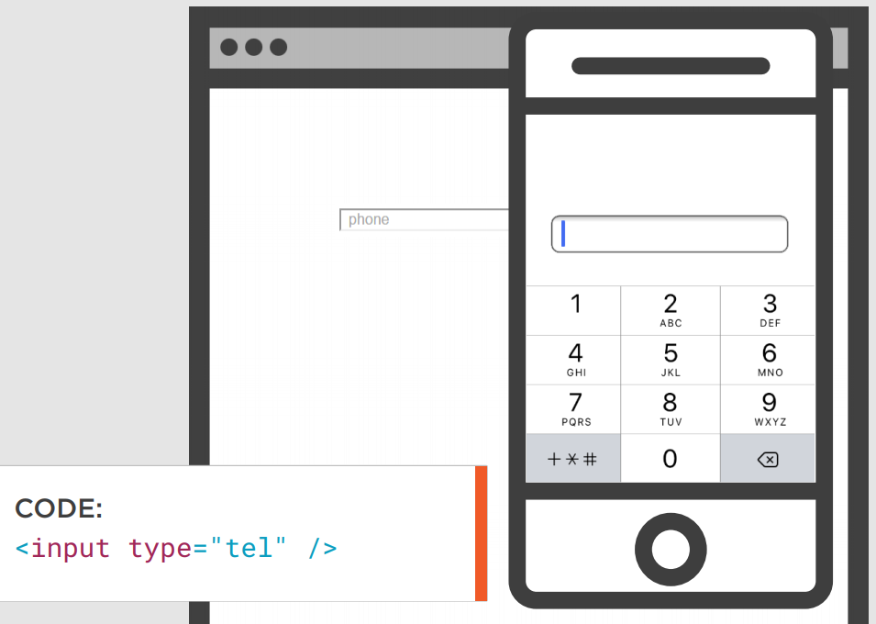
Tel
The <input type="tel"> is used for input fields that should contain a telephone number

Slide 32
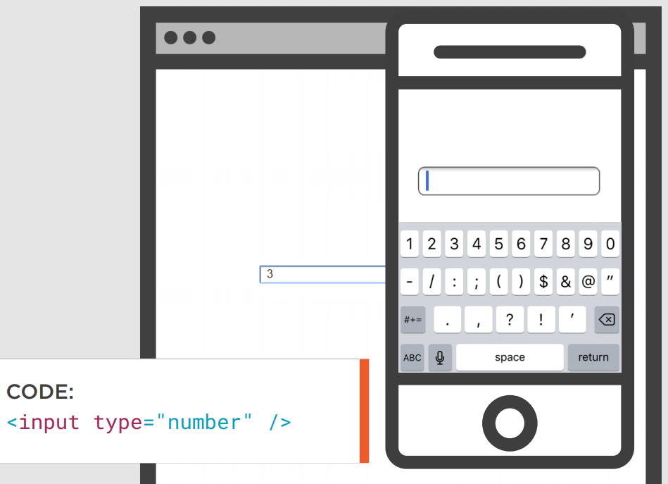
Number
The <input type="number"> defines a numeric input field
You can also set restrictions on what numbers are accepted (min, max)

Slide 33
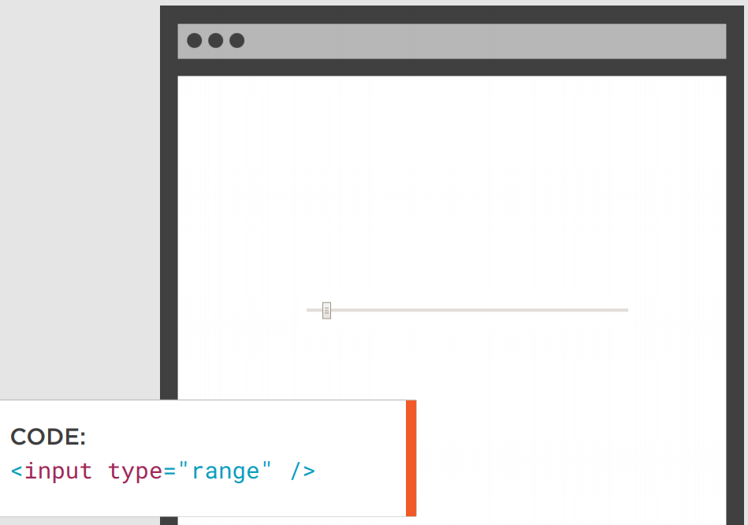
Range
Defines a control for entering a number whose exact value is not important (like a slider control)
Default range is 0 to 100. However, you can set restrictions on what numbers are accepted (min, max, step)

Slide 34
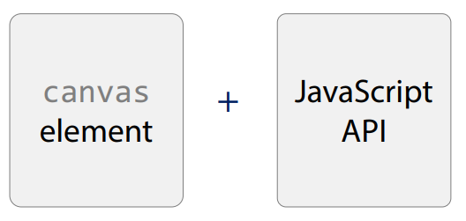
Graphics - Canvas
The HTML <canvas> element is used to draw graphics, on the fly, via JavaScript
The <canvas> element is only a container for graphics. You must use JavaScript to actually draw the graphics
Canvas has several methods for drawing paths, boxes, circles, text, and adding images

Slide 35
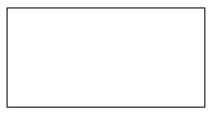
Graphics - Canvas
A canvas is a rectangular area on an HTML page
By default, a canvas has no border and no content
The markup looks like this:
Sample: https://jsfiddle.net/broux00/n2EYw/

Slide 36
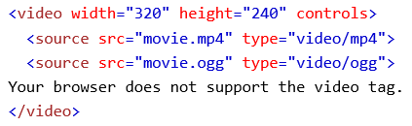
Media elements - Video
Before HTML5, a video could only be played in a browser with a plug-in (like flash)
The HTML5 <video> element specifies a standard way to embed a video in a web page
Sample https://jsfiddle.net/esedic/xt78yqu9/

Slide 37
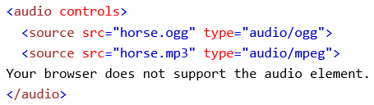
Media elements - Audio
Before HTML5, audio files could only be played in a browser with a plug-in (like flash)
The <audio> element specifies a standard way to embed audio in a web page
Sample http://jsfiddle.net/dsuket/jTh3v/

Slide 38
New APIs - Geolocation
The HTML Geolocation API is used to get the geographical position of a user
Since this can compromise privacy, the position is not available unless the user approves it
Geolocation is most accurate for devices with GPS, like smartphone
Samples
https://codepen.io/tag/geolocation/

Slide 39
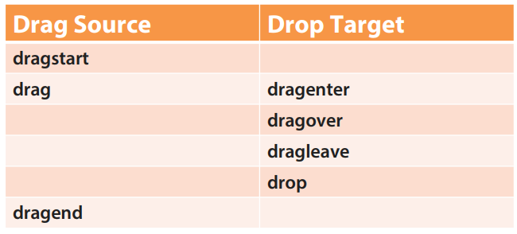
New APIs – Drag and Drop
In HTML5, drag and drop is part of the standard: Any element can be draggable
To make an element draggable, set the draggable attribute to true
Events
Sample https://codepen.io/pushpanathank/pen/MKPwej?editors=1111

Slide 40
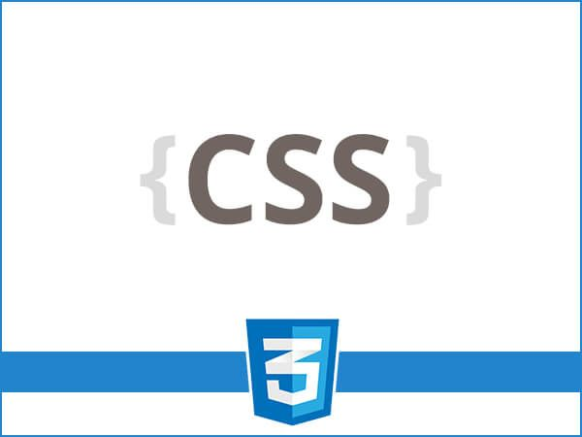

Slide 41
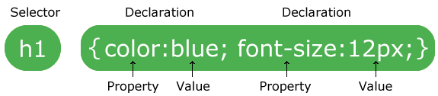
CSS
Cascading Style Sheets
Describes how HTML elements are displayed on screen
It can control the layout of multiple web pages all at once
Syntax
Notes:
The selector points to the HTML element you want to style.
The declaration block contains one or more declarations separated by semicolons.
Each declaration includes a CSS property name and a value, separated by a colon.
A CSS declaration always ends with a semicolon, and declaration blocks are surrounded by curly braces.

Slide 42
Selectors
Used to "find" (or select) the HTML elements you want to style
Selector | Example | Description
.class | .intro | Selects all elements with class="intro"
#id | #firstname | Selects the element with id="firstname"
* | * | Selects all elements
element | p | Selects all <p> elements
element,element,.. | div, p | Selects all <div> elements and all <p> elements
Notes:
Show element, class, and id example

Slide 43
Referencing CSS
There are 3 ways to add styles:
External
Internal
Inline
Notes:
Precedencia
Enseñar el ejemplo -> Dev tools
Método recomendado > ventajas

Slide 44
Commonly used CSS
color
background-color
background-image
border
margin
padding
height / width
font
display
position
float
transitions
transformations
Media Queries

Slide 45


Slide 46
Sass
Syntactically awesome style sheets
Reduces repetition of CSS and saves time
It’s a CSS extension and pre-processor
Browsers don’t understand .scss, so you need to transpile them
It lets you use features that do not exist in CSS, like variables, nested rules, mixins, imports, inheritance,
It also provides some built-in functions for strings, numbers, lists, map, selector, color, and introspection functions

Slide 47


Slide 48
JavaScript
JS is a high-level, interpreted scripting language that conforms to the ECMAScript specification
JavaScript enables interactive web pages and is an essential part of web applications
Main characteristics:
Curly-bracket syntax
Dynamic typing
Prototype-based object-orientation
First-class functions

Slide 49
JavaScript Keywords
Keyword | Description
break | Terminates a switch or a loop
continue | Jumps out of a loop and starts at the top
debugger | Stops the execution of JavaScript, and calls (if available) the debugging function
do ... while | Executes a block of statements, and repeats the block, while a condition is true
for | Marks a block of statements to be executed, as long as a condition is true
function | Declares a function
if ... else | Marks a block of statements to be executed, depending on a condition
return | Exits a function
switch | Marks a block of statements to be executed, depending on different cases
try ... catch | Implements error handling to a block of statements
var, let, const | Declares variables and constants

Slide 50

JS HTML DOM
When a web page is loaded, the browser creates a Document Object Model of the page
The HTML DOM model is constructed as a tree of Objects

Slide 51
JS HTML DOM
With the object model, JavaScript gets all the power it needs to create dynamic HTML:
JavaScript can change all the HTML elements in the page
JavaScript can change all the HTML attributes in the page
JavaScript can change all the CSS styles in the page
JavaScript can remove existing HTML elements and attributes
JavaScript can add new HTML elements and attributes
JavaScript can react to all existing HTML events in the page
JavaScript can create new HTML events in the page

Slide 52


Slide 53
jQuery
jQuery is a lightweight, "write less, do more", JavaScript library
The purpose of jQuery is to make it much easier to use JavaScript on your website
It encapsulates common tasks that would require many lines of JS, and wraps them into reusable methods in a single line of code
jQuery resolved the cross-browser issues. It runs exactly the same in all major browsers

Slide 54
jQuery main features
HTML/DOM manipulation
CSS manipulation
HTML events methods
Effects and animations
Ajax
Deferred and Promise objects for async processing
Utilities, such as feature detection
Extensibility through plug-ins

Slide 55


Slide 56
TypeScript
TypeScript is an open-source programming language developed and maintained by Microsoft
It is a strict syntactical superset of JavaScript, so existing JavaScript programs are also valid TypeScript programs
TypeScript is designed for development of large applications and transcompiles to JavaScript
TypeScript may be used to develop JavaScript applications for both client-side and server-side execution

Slide 57
TS main features
Type annotations
Compile-time type checking
Interfaces
Classes
Enumerated types
Generics
Namespaces
Async/await

Slide 58


Slide 59

History and evolution
Notes:
There was a need to not only have richest apps, but also that they have a great reach.
That’s how current Web Applications started
They begin live as a 100% web app which give us the reach we were looking for, but they also have the ability to be enhanced into rich applications.
They are not really a new concept, because most of the technologies have been around for quite a while.
What makes them special is that we put them together to serve this purpose

Slide 60
SPA
Single Page Application
It is a web application that interacts with the user by dynamically rewriting the current page rather than loading entire new pages from a server
This approach avoids interruption of the user experience between successive pages, making the application behave more like a desktop application

Slide 61

Multi-Page Web Site
Cliente
Servidor
http request
Base de Datos
Web
Server
http response

Slide 62
SPA – first request
Cliente
Servidor
http request
Web
Server
http response

Slide 63

SPA – subsequent requests
Cliente
Servidor
async request
Base de Datos
API
http response
Notes:
Hablar son Micro-Servicios

Slide 64
Micro Services (APIs)
Microservice architecture, or simply microservices, is a distinctive method of developing software systems that tries to focus on building single-function modules with well-defined interfaces and operations
Benefits:
Simpler to deploy
Simpler to understand
Reusability
Faster defect isolation
Minimize risk of change
Notes:
Simpler To Deploy - Deploy in literal pieces without affecting other services.
Simpler To Understand - Follow code easier since the function is isolated and less dependent.
Reusability Across Business - Share small services like payment or login systems across the business.
Faster Defect Isolation - When a test fails or service goes down, isolate it quickly with microservices.
Minimized Risk Of Change - Avoid locking in technologies or languages - change on the fly without risk.

Slide 65
JSON
JavaScript Object Notation
It is a syntax for storing and exchanging data
JSON is text, written with JavaScript object notation
Syntax:
Data is in name/value pairs
Data is separated by commas
Curly braces hold objects
Square brackets hold arrays

Slide 66
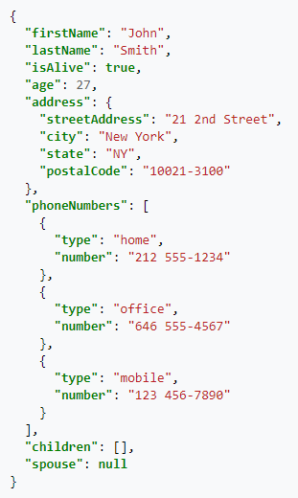
JSON example

Slide 67
JSON vs XML
Both JSON and XML can be used to receive data from a web server
Both are self-describing
Both are hierarchical
JSON advantages:
JSON doesn’t use end tag
JSON is shorter
JSON is quicker to read and write
JSON can use arrays

Slide 68
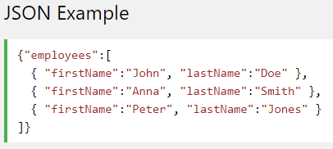
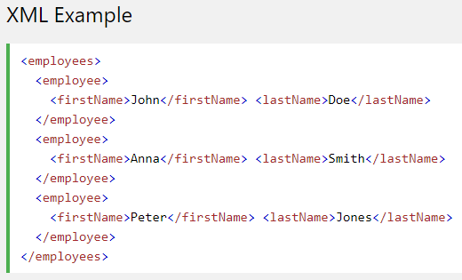
JSON vs XML

Slide 69


Slide 70
What is Progressive Web Apps?
Progressive Web Apps are experiences that combine the best of the web and the best of apps. They are useful to users from the very first visit in a browser tab, no install required. As the user progressively builds a relationship with the app over time, it becomes more and more powerful. It loads quickly, even on flaky networks, sends relevant push notifications, has an icon on the home screen, and loads as a top-level, full screen experience.
“…they’re just websites that took all the right vitamins.”

Slide 71
PWA Characteristics
Progressive - Works for every user, regardless of browser choice because it's built with progressive enhancement as a core tenet.
Responsive - Fits any form factor: desktop, mobile, tablet, or whatever is next.
Connectivity independent - Enhanced with service workers to work offline or on low-quality networks.
App-like - Feels like an app, because the app shell model separates the application functionality from application content.
Fresh - Always up-to-date thanks to the service worker update process.

Slide 72
PWA Characteristics
Safe - Served via HTTPS to prevent snooping and to ensure content hasn't been tampered with.
Discoverable - Is identifiable as an "application" thanks to W3C manifest and service worker registration scope, allowing search engines to find it.
Re-engageable - Makes re-engagement easy through features like push notifications.
Installable - Allows users to add apps they find most useful to their home screen without the hassle of an app store.
Linkable - Easily share the application via URL, does not require complex installation.

Slide 73


Slide 74
MVC
Model View Controller
Design pattern used for developing user interface which divides the related program logic into three interconnected components
Model: responsible for managing the data of the application. It receives user input from the controller
View: representation of the model in a particular format
Controller: responds to the user input and performs interactions on the data model objects. The controller receives the input, optionally validates it and then passes the input to the model

Slide 75

MVC

Slide 76
Technologies
Bootstrap: open source toolkit for developing with HTML, CSS, and JS
Mongo: cross-platform document-oriented database program
PostgreSQL: free and open-source relational database management system
Angular: TypeScript-based open-source web application framework developed by Google
React: JavaScript library for building user interfaces maintained by Facebook
NodeJS: open-source, cross-platform, JavaScript runtime environment that executes JavaScript code outside of a browser
Express.js: open-source web application framework for Node.js
Many more (Sails, Vue, Docker, etc)

Slide 77
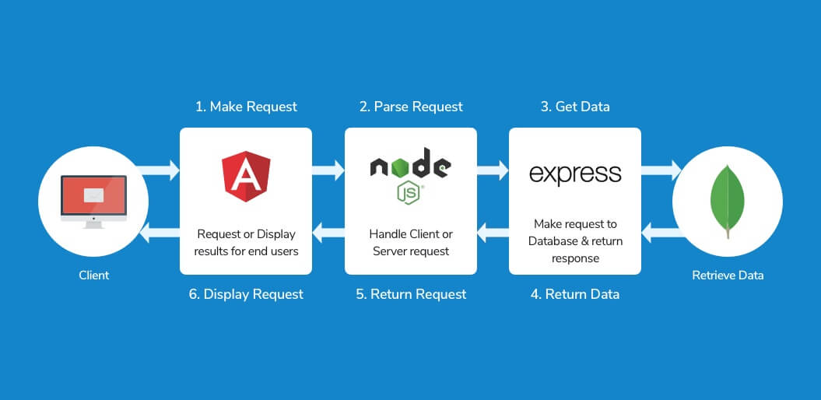
MEAN Stack

Slide 78
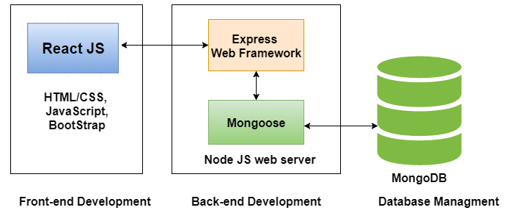
MERN Stack

Slide 79
Prework

Slide 80
Prework
Laptop
Internet connection
IDE (Visual Studio Code)
NodeJS installed

